Slide 1

Introducing the dedicated team driving the Digital Doctor for Farmers project, from vision to execution.
Project Foundation
Team Members
Problem Statement ID: PS7
Team Name: Hack Hunters
Team ID: HK - 013
Gaurang Mudgil
Aryan Gupta
Ritesh Kumar
Notes:
1

Slide 2
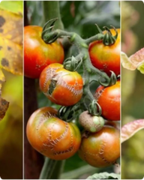


Problem — Why Farmers Need Agrimitra?
Late detection
Confusing guidance
Connectivity limits
Crop diseases often go unnoticed until widespread, causing severe yield loss.
Mismatched pesticide use, unsafe mixes, and unclear dosages increase costs and risk.
Rural networks and device constraints block access to expert advice at point of need.
Solution (summary): an on-device-first CV model + geolocation + multilingual NLP to diagnose, recommend, and guide a 7-day treatment plan with voice in local dialects.
Notes:
2

Slide 3
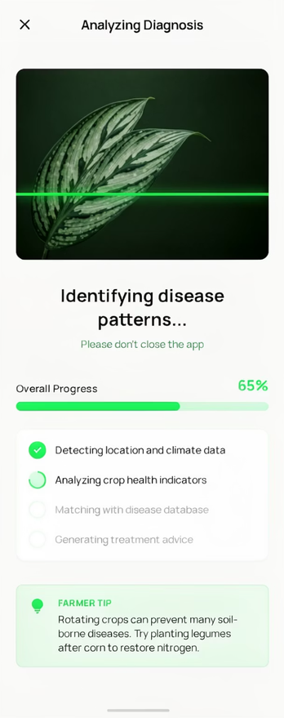
Digital Doctor for Farmers— AGRIMITRA
Mobile-first prototype that diagnoses crop diseases from photos, provides location-specific treatment plans based on local crop and weather conditions, and communicates in regional dialects through text and voice. Optimized for low-bandwidth settings, it supports quick, on-field use by smallholder farmers with a simple, intuitive interface.
Notes:
3

Slide 4

Solution Flow — From Photo to Plan
Capture Image
On-device Inference
Cloud Verify & Lookup
7-day Plan & Follow-up
Fast local inference for immediate triage, cloud-backed verification and tailored advice based on crop, soil, location, and seasonal pest data.
Notes:
4

Slide 5

Core Features (Functional Requirements)
Image upload & multi-angle capture for accuracy
Disease & pest detection (confidence score)
Location-based agri-recommendations (microclimate + regulations)
Local dialect support — text & TTS voice
Pesticide / soil treatment guidance & safety notes
Structured 7-day action plan with checkpoints
Diagnosis history & exportable reports
Notes:
5

Slide 6
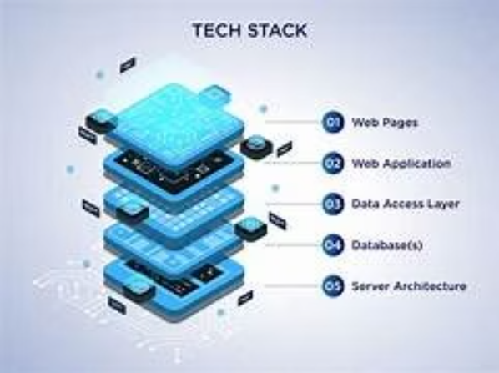
Technical Architecture & Stack
Frontend: React.js + PWA (offline caching, camera + microphone access).
Backend: Node.js + Express for API gateway; Python (FastAPI optional) for ML services.
ML: Convolutional neural networks for plant disease detection (on-device quantized model + cloud ensemble).
Geo & Data: Geolocation + weather API integration; scalable cloud DB and knowledge base for crop/pesticide rules.
Optimization: Image compression, delta-sync, adaptive bitrate TTS for low bandwidth.
Notes:
6

Slide 7
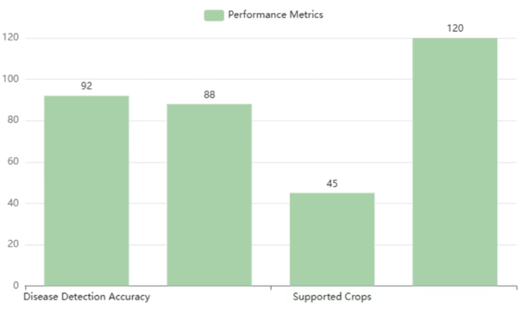
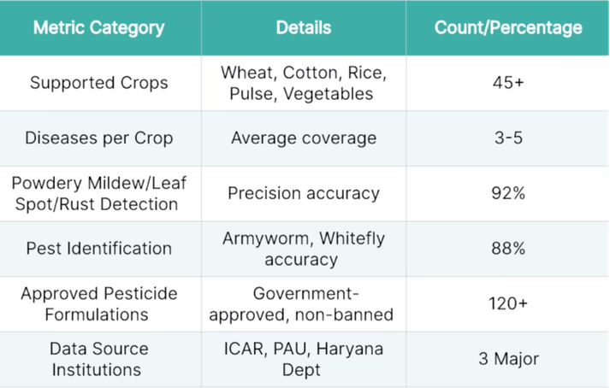
Disease Detection Accuracy & Knowledge Base
Supported Disease Coverage
Platform covers 45+ common crops including wheat, cotton, rice, pulse, and vegetables with 3-5 diseases per crop, enabling comprehensive crop health monitoring and disease identification across diverse agricultural scenarios.
Detection Performance Metrics
Achieves 92% precision for powdery mildew, leaf spot, and rust detection; 88% accuracy for pest identification including armyworm and whitefly, ensuring reliable disease diagnosis for farmer decision-making.
Notes:
7

Slide 8
Uniqueness & Innovation
On-device first inference
Location-aware advice
Instant triage with compressed models to avoid network dependency.
Recommendations tailored to microclimate, local regulations and crop calendar.
Multilingual NLP + TTS
Actionable 7-day plans
Dynamic dialect models for accurate, culturally appropriate guidance — text and voice.
Operable steps with reminders, safety checks, and escalation triggers.
Notes:
8

Slide 9
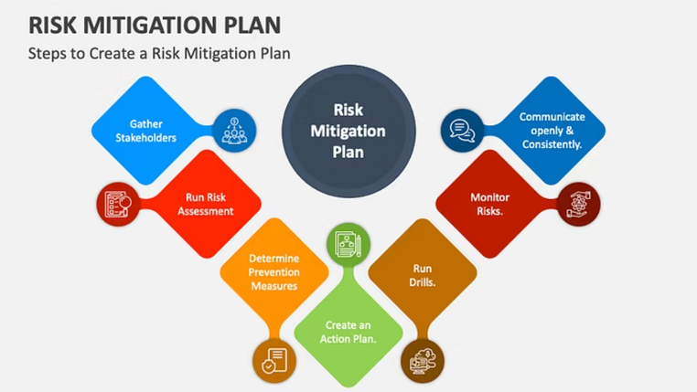
Feasibility, Risks & Mitigations
Data quality risk — Mitigation: active learning loop; crowdsourced labeled photos with expert validation.
Connectivity constraints — Mitigation: PWA offline-first, on-device models, scheduled background sync.
Model generalization — Mitigation: regional fine-tuning and federated updates to preserve bandwidth/privacy.
Regulatory & safety concerns — Mitigation: integrated safety warnings, local pesticide regulation mapping, expert escalation flow.
Notes:
9

Slide 10
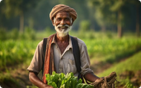


Market Opportunity & Impact
Large addressable market
Yield & income gains
Extension amplification
Empower 1M+ smallholder farmers with AI disease detection, cutting crop losses by 30%, reducing treatment costs by 40%, and saving ₹2,000+ per acre annually.
Boosts yield and income. Free plan: 2 diagnoses/month; ₹99/month for unlimited access. Saves ₹1,500–2,700 per acre each season vs ₹3,500+ wasted on trial-and-error pesticides.
Tool augments extension services, enabling scale with localized content and voice guidance.
Notes:
10

Slide 11
Research, Data Sources & References
Primary inputs: peer-reviewed plant pathology datasets, open geo-climate APIs, national pesticide registries, and regional extension corpora. Suggested references:
PlantVillage / PlantDoc image datasets (disease labels)
FAO guidelines on integrated pest management
Local agriculture department pesticide registries (country-specific)
Low-bandwidth UX best practices and PWA guidelines
Notes:
11

Slide 12

Next Steps & Ask
1. Prototype & field test
2. Data loop & refine
3. Scale & integrate
Build MVP (React PWA + on-device model) and run 4-week pilots with 50 farms.
Collect labeled photos, expert reviews, and iterate model + NLP dialects.
Connect with extension services, NGOs and deploy cloud scale + regional knowledge bases.
Ask: mentorship for model validation, pilot partners (extension networks), and seed resources for a 3-month pilot. I will present a working demo on request.
Notes:
12

Slide 13


Thank You!
We appreciate your time and consideration of the Digital Doctor for Farmers. We are excited about the potential to empower smallholder farmers and transform agricultural practices.
Notes:
13

